Slide 1

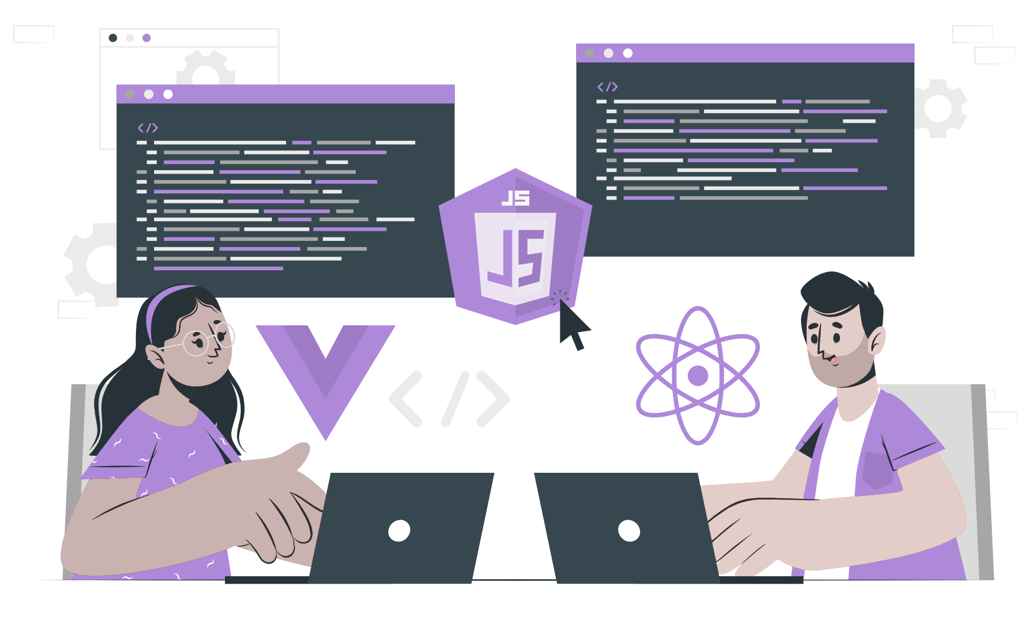
What are Conditions, If, If-else, if-else-if

Slide 2
Lecture CheckList
Conditionals in Programming.
Conditionals in JavaScript.
Ways of writing conditionals in Javascript.
Introduction to if, if-else, and if-else if.
Check if the given number is even or odd.
Order of evaluation for if, else if, and else statements.

Slide 3
Conditionals in Programming.
Programming Languages are tools that allow us to write code that instructs the computer to do something. In every programming language, the code needs to make decisions and carry out actions accordingly depending on different inputs.
Human beings make decisions all the time. For example, every morning, we make a decision between eating or not eating before starting our daily chores. Conditional statements allow us to represent such decision-making in JavaScript, from the choice that must be made.

Slide 4
Conditionals in JavaScript.
JavaScript is a programming language that is commonly used to create interactive and dynamic elements on websites. One of the key features of JavaScript is the ability to use conditional statements to control the flow of a program.
Conditions work on boolean values, true or false. It is true if it meets the requirement, false otherwise. That is expressions (conditions) are evaluated to be either true or false.

Slide 5
There are three ways of writing conditionals in Javascript:
If/else Statement
Switch Statement
Ternary Operator
In this lecture let’s look at the basic syntax of these conditionals and later will look at the code along with examples.

Slide 6
If statement
The most basic form of a conditional statement is the if statement.
The condition is any expression that can be evaluated as true or false. For example, you can use a comparison operator (such as <, >, ==) to compare two values, or you can use a logical operator (such as &&, ||) to combine multiple conditions.

Slide 7
Else statement
An if statement can also include an optional else statement, which will execute if the condition is false.

Slide 8





























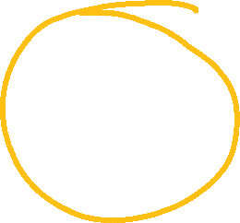
































Else if
JavaScript also supports the use of else if statement, which allows you to chain multiple conditions together.
You can chain as many else if as you want

Slide 9
Ternary Operator
JavaScript also has a ternary operator, which is a shorthand way to write a simple if-else statement.

Slide 10
Switch Statement
JavaScript also has a switch statement. A switch statement allows you to check for multiple conditions and execute different codes depending on the value of a particular expression.
The switch statement is useful when you have a large number of conditions to check and the conditions are based on the value of a single expression.
Notes:
Conditional statements in JavaScript are an important tool for controlling the flow of a program. They allow you to execute different codes depending on the outcome of an evaluation, and they come in several forms: if-else, else-if, ternary operator, and switch statement. Understanding how and when to use these statements is essential for writing effective JavaScript code.

Slide 11
Introduction to if, if-else, and if-else if.
The if, else, and else if keywords are used in programming to control the flow of a program based on certain conditions. These conditions are typically evaluated as either true or false.

Slide 12
Check if the given number is even or odd.
Before, solving any problem through programming it is important to first analyze what is the input that will be taken, what are the conditionals involved, and what is the output expected.
In this case, we will be taking integers are input. The output is expected to be a message telling if the number is even or odd.

Slide 13
Conditions
The conditions to be considered to solve this problem are
Any number that is completely divisible [ remainder must be 0 ] by 2 then it is an even number.
Any number that is not completely divisible [ remainder must be 0 ] by 2 then it is an odd number.
Zero is neither an odd number nor an even number.

Slide 14
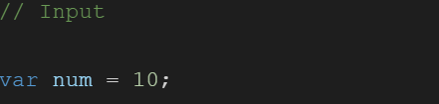
Check if the given number is even or odd.
In the above block of code, we have declared a variable named "num" and assigned it the value of 10. The variable num will be our input.

Slide 15
Check if the given number is even or odd.
Now let’s handle the condition number 01 that is if any number that is completely divisible [ remainder must be 0 ] by 2 then it is an even number.
To check if the number is completely divisible by 2 we will be making use of the modulo operator which returns the remainder. If the result of the modulo operation is 0 then the number is even.
From the previous lecture, we know the syntax of the if statement, and we will write the code considering the same syntax.

Slide 16
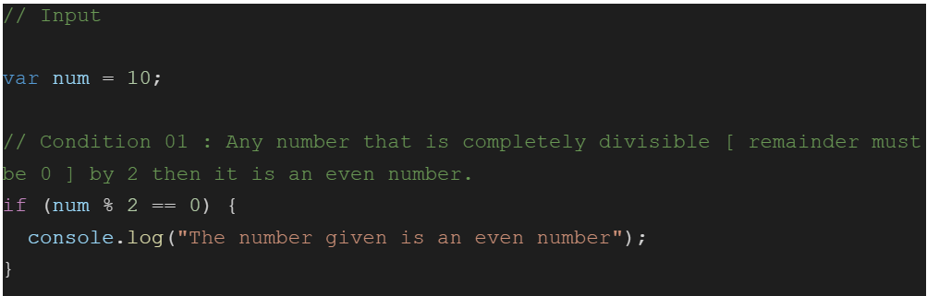
Check if the given number is even or odd.
This code block checks if the variable "num" is an even number using an if statement. The if statement checks the condition num % 2 == 0.
Notes:
The modulus operator % is used to find the remainder of dividing the variable "num" by 2.
If the remainder is 0, it means that the number is completely divisible by 2 and it is an even number.
If the condition is true, the code inside the if block will be executed, which is console.log("The number given is an even number");. This will output the message "The number given is an even number" to the console, confirming that the number is even.

Slide 17
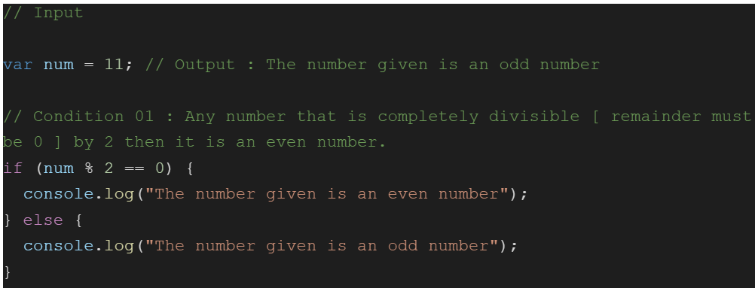
Check if the given number is even or odd.
It’s time to handle the second condition which is any number that is not completely divisible [ remainder must be 0 ] by 2 then it is an odd number.
As we have already checked for the even number condition, now if the condition for even fails it is an odd number. We can check this through the else statement.
Notes:
Now the code is capable of checking if the given number is odd or even.

Slide 18
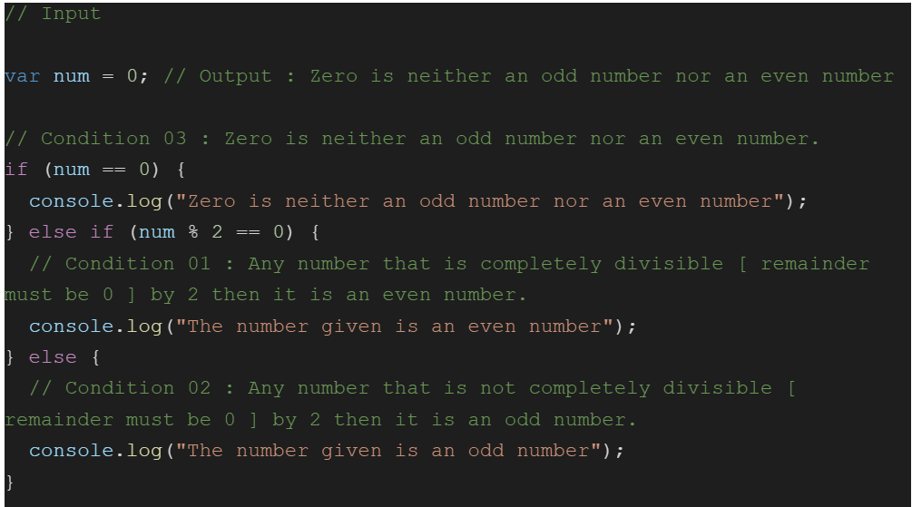
Check if the given number is even or odd.
We also have our third condition which is zero is neither an odd number nor an even number. So the first condition we need to check is if the number is zero, then if the number is even, and at last, if both the condition fails it is an odd number.
Notes:
Now the code is capable of checking if the given number is odd or even.

Slide 19
Order of evaluation
In JavaScript, the order of evaluation for if, else if, and else statements are as follows:
The if statement is evaluated first. If the condition in the if statement is true, the code inside the if block will be executed and the program will skip over any subsequent else if or else statements.
If the condition in the if statement is false, the program will move on to the next else if statement and evaluate its condition. If the else if the condition is true, the code inside its block will be executed and the program will skip over any remaining else if or else statements.
If all of the if and else if conditions are false, the program will move on to the else statement and execute the code inside its block.

Slide 20
THANK YOU

